Slide 1
Software Engineering
Lesson – UML Class Diagrams

Slide 2
Lesson Content
What is an object?
What is a class?
OO principles: Encapsulation, inheritance, polymorphism
Class Diagram Notation

Slide 3
Object Oriented Concepts

Slide 4

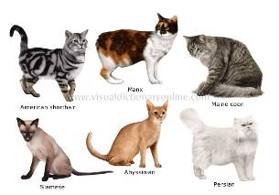
What is an object?
An object is any entity which is complex enough to have data attributes and certain behavior
3 characteristics: state, behavior and a unique id.
The state of an object is all the data which it currently holds. This is stored in named attributes or fields
Behaviour is the way an object acts and reacts as a result of messages received, and based on its state. This is achieved through methods
Every object is unique, even if they belong to the same group (class) and were built using same template
Object-oriented system is a collection of objects which are sending messages to each other (calling each others methods) in order to accomplish a certain task [1]

Slide 5
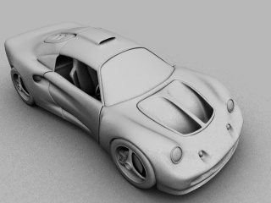

Example of Objects
Tangible things
Car, plane, boat
Roles
Student, customer, inspector
Incidents
Booking, arrival
Interactions
Contract, marriage
Specifications
Order, recipe

Slide 6
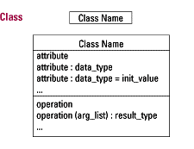
What is a class?
Class
A description of a set of objects that share the same attributes, operations, relationships and semantics (meaning)
A class is effectively a template from which objects are created (instantiated).
3 sections
Class Name
Attributes
An attribute represents some property of the thing you are modeling that is shared by all objects of the class
Operations
An operation is an abstraction of something you can do to an object and that is shared by all objects of that class

Slide 7
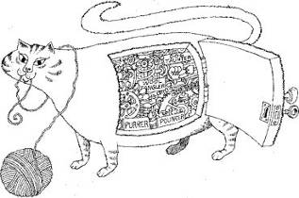
Encapsulation
Joining data fields and functions in a single unit (class) is encapsulation.
Data cannot be accessible to the outside world and only those functions which are stored in the class can access it.[3]
Encapsulation is most often achieved through information hiding (not just data hiding), which is the process of hiding all the secrets of an object that do not contribute to its essential characteristics [4]

Slide 8
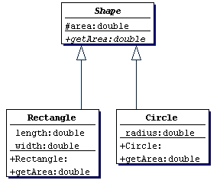
Idea of Inheritance: Re-use
If you need a new class and there is already a class that includes some of the code that you want, derive your new class from the existing class.
Thus, you reuse the fields and methods of the existing class without having to write (and debug!) them yourself

Slide 9
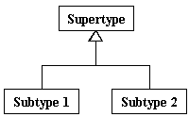
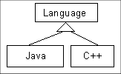
Inheritance (Generalization) guidelines
Inheritance models “is a” and “is like” relationships, enabling you to easily reuse existing data and code.
When “A” inherits from “B” we say that “A” is the subclass of “B” and that “B” is the superclass of “A.”
Furthermore, we say that we have “pure inheritance” when “A” inherits all of the attributes and methods of “B.”

Slide 10
Superclass / Subclass
A subclass can inherit all of the public and protected attributes and operations from its superclass
The inherited fields can be used directly, just like any other fields.
A subclass can add extra attributes and operations
You can declare a field in the subclass with the same name as the one in the superclass, thus hiding it (not recommended).
You can write a subclass constructor that invokes the constructor of the superclass, either implicitly or by using the keyword super().

Slide 11
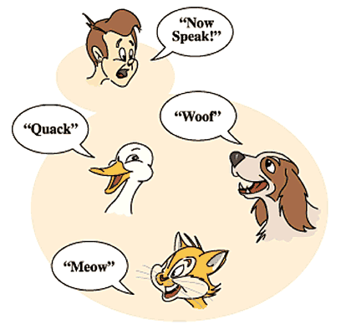
Polymorphism
The term Polymorphism comes from a Greek word meaning ‘having many shapes’.
Polymorphism is the idea of allowing operations of different object classes to have the same name, although the details of the actual operations may be different
Overloading and overriding are two types of polymorphism
A subclass may override (replace)/overload (add with same name but different arguments) some superclass methods

Slide 12
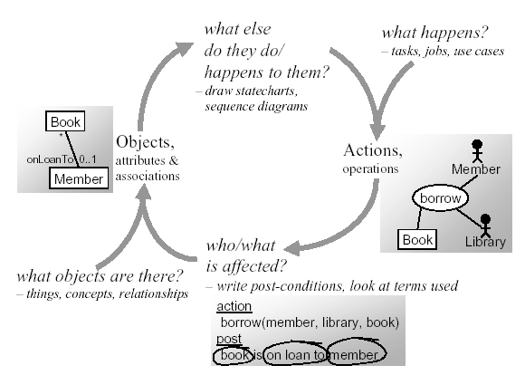
Object Oriented Analysis Flow

Slide 13
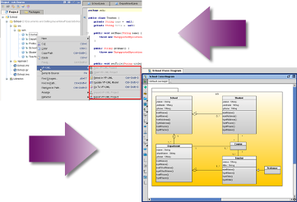
The benefits of object-oriented analysis and design
Possibility of smooth transition and backtracking (forward and backward engineering)
Tools which assist both forward and reverse engineering are called a round-trip tools
Objects correspond more closely to the entities in the conceptual worlds of the designer and user, leading to greater seamlessness and traceability;
Data is encapsulated, reducing the possibility of unexpected modifications
Object-based design is suitable for distributed, parallel or sequential development;
Inheritance and polymorphism make OO systems more extensible, contributing thus to more rapid development.

Slide 14
UML Class Diagrams

Slide 15
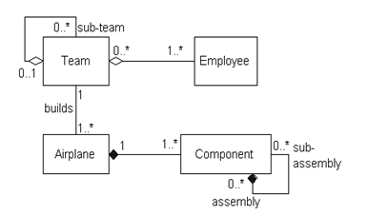

Class Diagrams
Humans love to classify and organize to help their understanding.
Classes are a way of grouping lots of related objects from the perspective of structure [2]
A diagram that shows the classes of the system, their inter-relationships, and the operations and attributes of the classes.
Similar to ERD
It is the most common diagram found in modeling of Object-Oriented Systems
Models a vocabulary of a system
Important not only for visualizing, specifying, and documenting structural models, but also for constructing executable systems through forward and reverse engineering

Slide 16
Class Style Guidelines
Use Common Terminology for Names
Prefer Complete Singular Nouns for Class Names
Name Operations with a Strong Verb
Name Attributes With a Domain-Based Noun
Initial Name | Good Analysis Name | Good Design Name | Issue
Open Acc | Open Account | openAccount() | An abbreviation was replaced with the full word to make it clear what is meant.
Mailing Label Print | Print Mailing Label | printMailingLabel() | The verb was moved to the beginning of the name to make it active.
purchaseparkingpass() | Purchase Parking Pass | purchaseParkingPass() | Mixed case was applied to increase the readability of the design-level name.
Save the Object | Save | save() | The name was shortened because the term “TheObject” did not add any value.

Slide 17
How To Find Classes
Begin by listing Candidate object classes found in the problem statement or use case description
Eliminate
Bad
Classes
Problem
Statement
Extract
Nouns
Potential
Candidate
Classes
Good
Classes

Slide 18
Underlining Nouns
An automatic teller machine accepts a cash card, interacts with the user, communicates with the central system to carry out the transaction, dispenses cash, and prints receipts. The system requires appropriate record keeping and security provisions. The system must handle concurrent accesses to the same account correctly. The banks will provide their own software for their own computers; you are to design the software for the ATMs and the network. The cost of the shared system will be apportioned to the banks according to the number of customers with cash cards.

Slide 19
Candidate Classes
From Problem Statement
ATM
Cash Card
User
Central
Computer
Transaction
Cash
Receipt
System
Recordkeeping
Provision
Security
Provision
Access
Account
Bank
Software
Bank
Computer
Cost
Customer
Network

Slide 20
Eliminating Bad Candidates.
Has this class a state (set of properties), behavior (set of operations) and identity?
Is it an attribute?
Is it an operation?
Is it an association?
Is the class redundant? (unnecessary, not relevant for the system under development)
Is the class unclear or too specific (concerned about the implementation details)?

Slide 21
Eliminating Bad Classes
Good Classes
Account
ATM
Bank
Cash Card
Customer
Transaction
Bad Classes
Attribute: receipt (of transaction), cash (of account)
Redundant: user
Irrelevant: cost
Vague (unclear): banking network, system
Implementation: software, access,

Slide 22
Relationships
There are several types of relationships that may appear on a class diagram:
An association
An inheritance
An aggregation
A composition

Slide 23
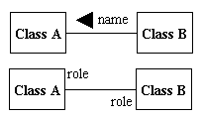
Association guidelines
Associations represent important static relationships between classes.
Place association name in the center above the association line.
Use a filled arrow to indicate the direction of the relationship.
Place roles near the end of an association.
Roles represent the way the two classes see each other.
Note: It's uncommon to name both the association and the class roles.

Slide 24
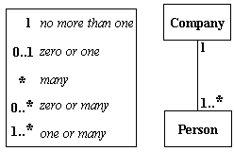
Associations guidelines: Multiplicity
Multiplicity (Cardinality) For each class involved in a relationship there will always be a multiplicity for it.
Place multiplicity notations near the ends of an association.
These symbols indicate the number of instances of one class linked to one instance of the other class.
For example, one company will have one or more employees, but each employee works for one company only.

Slide 25
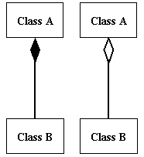

Aggregation and Composition
When a class is formed as a collection of other classes, it is called an Aggregation relationship between these classes. It is also called a "has a" relationship
Composition is a special type of aggregation that denotes a strong ownership between Class A, the whole, and Class B, its part. Illustrate composition with a filled diamond.
Note: Apply Composition to Aggregates of Physical Items
Apply Composition When the Parts Share The Persistence Lifecycle With the Whole

Slide 26
Building a Class Diagram
Identify the classes, name them, and define them so you know why they are part of the model.
Identify, name, and define the associations between pairs of classes. Assign multiplicity and constraints where needed.
Evaluate each association to determine whether it should be defined as aggregation.
If it is aggregation, then could it be composition?
Evaluate the classes for possible specialization or generalization.

Slide 27
Inheritance (Generalization) guidelines
Inheritance models “is a” and “is like” relationships, enabling you to easily reuse existing data and code.
When “A” inherits from “B” we say that “A” is the subclass of “B” and that “B” is the superclass of “A.”
Furthermore, we say that we have “pure inheritance” when “A” inherits all of the attributes and methods of “B.”

Slide 28
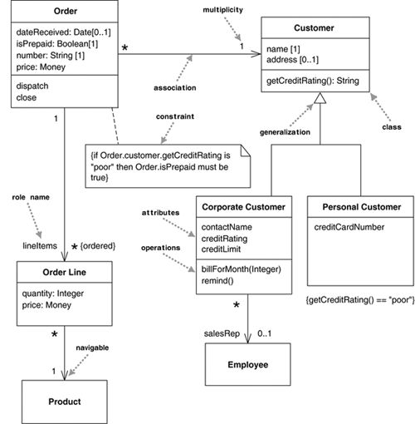
Class Diagram Example

Slide 29
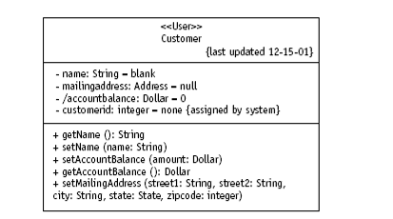
Enhancing the Class Diagram during the Design Stage

Slide 30
Attribute Visibility
Each attribute definition must also specify what other objects are allowed to see the attribute—that is its visibility.
Required before code generation
Visibility is defined as follows:
Public (+) visibility allows access to objects of all other classes.
Private (-) visibility limits access to within the class itself. For example, only operations of the class have access to a private attribute.
Protected (#) visibility allows access by subclasses. In the case of generalizations (inheritance), subclasses must have access to the attributes and operations of the superclass or they cannot be inherited.
Package (~) visibility allows access to other objects in the same package.

Slide 31
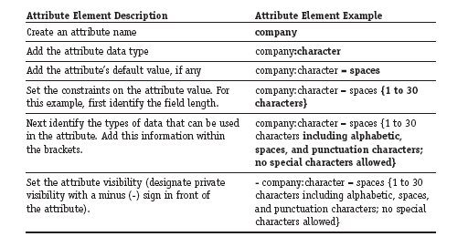
Attribute Specification
The field has to handle characters and punctuation marks commonly found in company names, limited to 30 positions.
The default value will be initialized the field to spaces.

Slide 32
Modeling a Method
Methods require a name, arguments, and sometimes a return.
Arguments, or input parameters, are simply attributes, so they are specified using the attribute notation (name, data type, [constraints, and default])
Example
totalOrderAmount (order : Order) : Dollar
{The total is the sum of all line items less the volume discount. Each line item is the product of the unit price and quantity.}

Slide 33
Types of Operations
It is also possible to distinguish between:
Query operations – do not change the observable state of an object
getName():String
Command operations – do change the state of an object; usually have no return value (not necessarily!)
setName(name:String)

Slide 34
Reference List
[1] Venters W, 2008, Software engineering: theory and application: chapter 7, pp 56-58, LSE, University of London
[2] Fowler M, 2003, UML Distilled. A Brief Guide to Standard Object Modelling Language, Addison Wesley, 3rd edition

Slide 35

End of Lesson
Any questions?

